Slide 1
OWASP Hackersproject
OWASP Hackersproject is open source web to hire the Hackers. find Hackers & hire Hackers

Slide 2
About me
Researcher & also a Co-founder of Security Just Illusion
CERT (Computer Emergency Response Team)
OWASP Indonesia (Jakarta) Chapter Leader
https://www.owasp.org/index.php/Ade_Yoseman_Putra

Slide 3
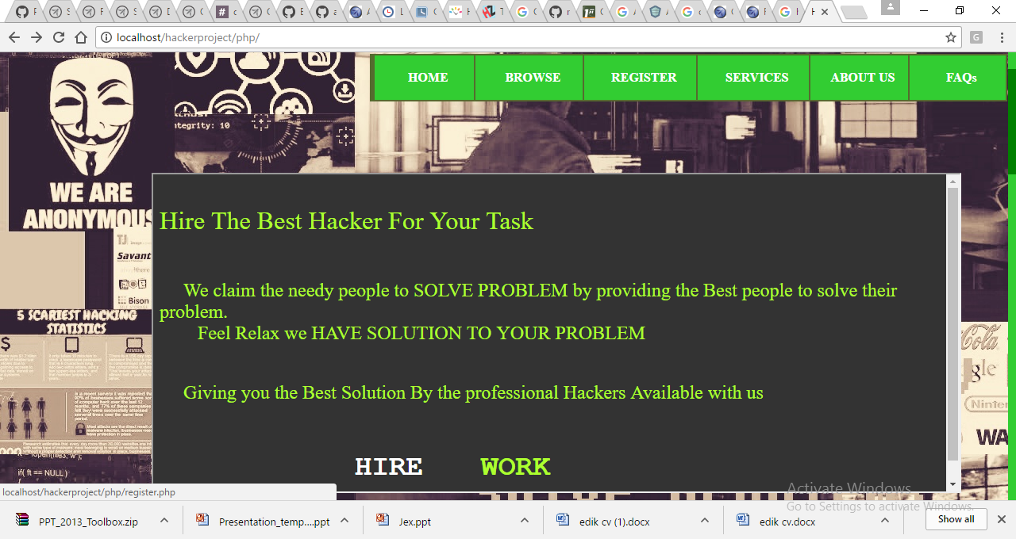

Slide 4
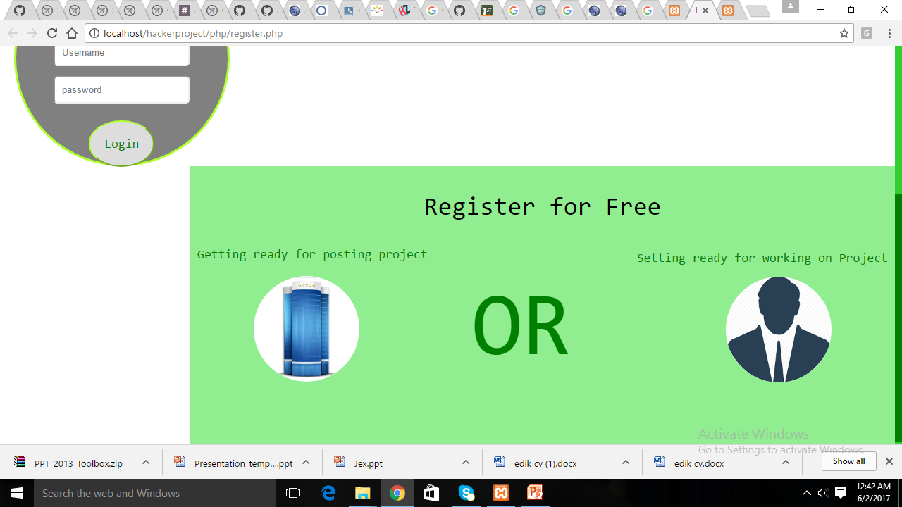
Register project

Slide 5
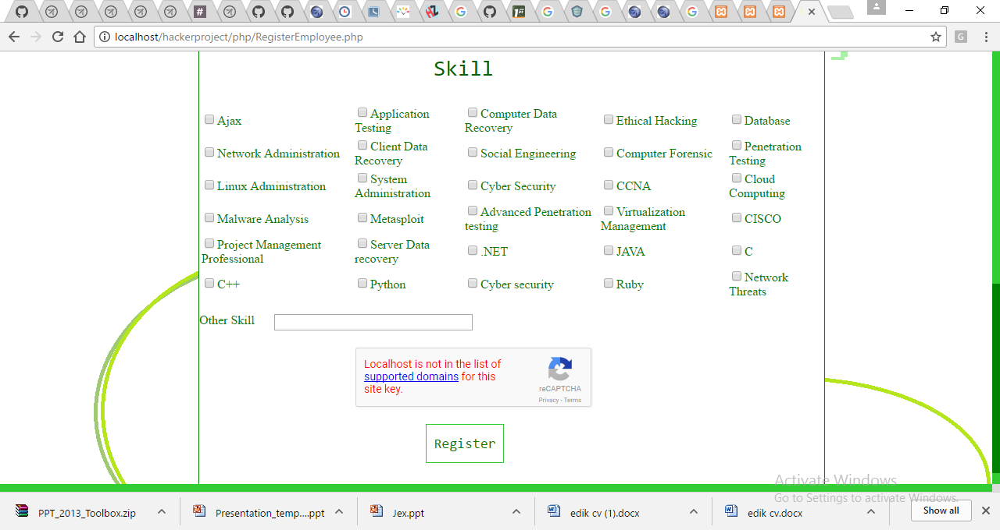
Register hacker

Slide 6
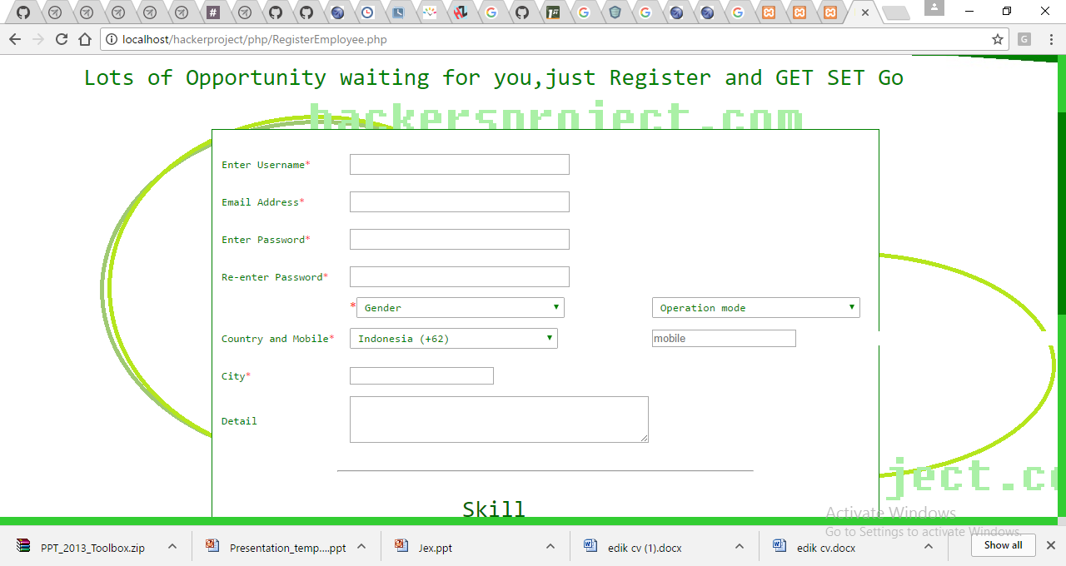
Register hacker

Slide 7
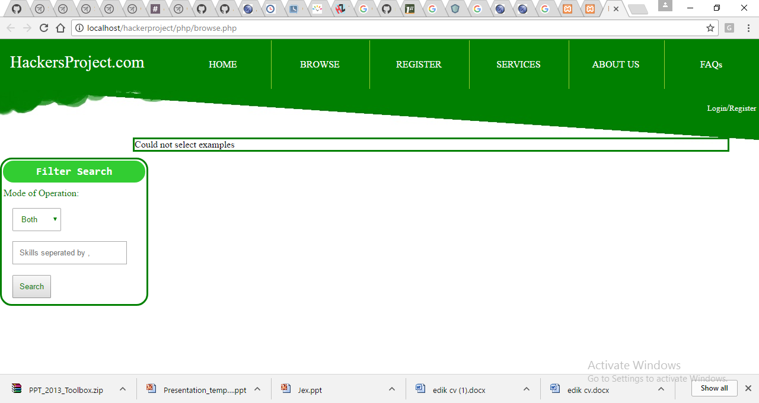
Find hacker

Slide 8
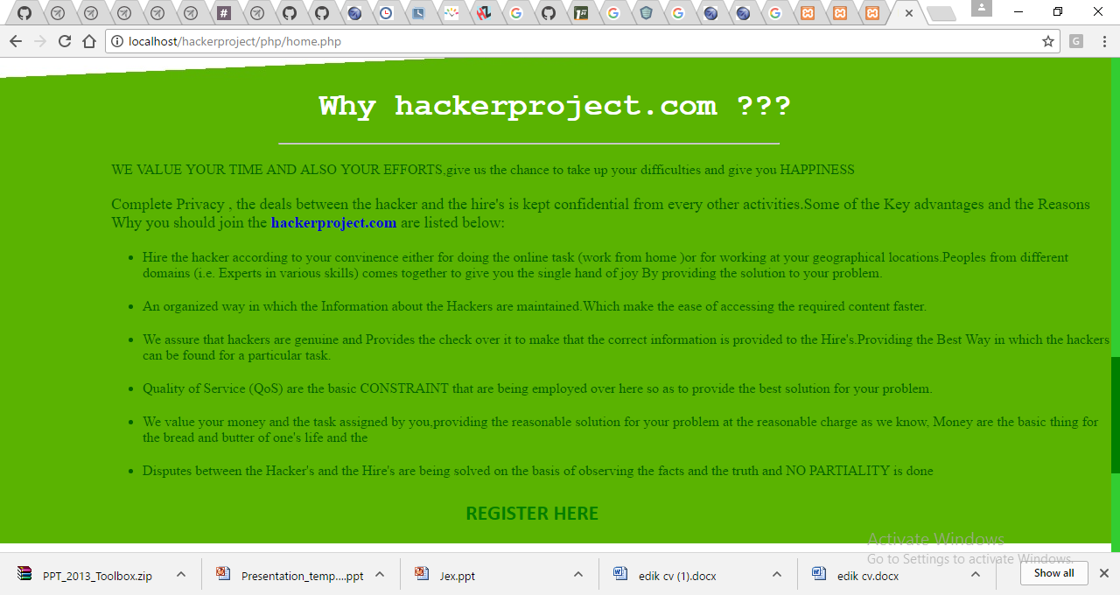
Why OWASP Hackersproject

Slide 9
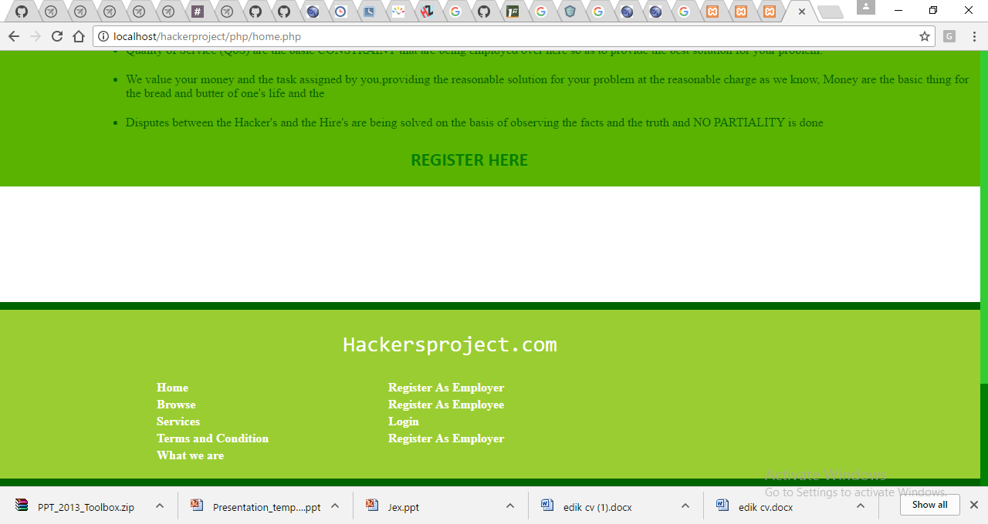
Thanks

